Slide 1
Digital Platform for “Professor- As - A Service”
By:
Adepu Sowmika – 002922551
Karnati Akhil – 002926123
Mannava Vivek – 002921511

Slide 2

Objectives
Our goal is to lower tuition costs while maintaining the same educational quality for a student around the world.
Coherent education is the prime objective minimizing repetition and fatigue in learning.
Lenient time constraints reduce pressure on the learner and enhance the learning process.
Through education and feedback, we want to hold people accountable for enhancing the quality of life.

Slide 3
Entities
Professor
Student
Course offering
Course registration
Course catalog
Transcripts

Slide 4

The purpose of this assignment is to show new business model and how it is different from traditional university model.
New business model provide services to both professor and students.
Professor can teach his subject when ever they want, Wherever they want, and It can be accessible to both students and professor.

Slide 5
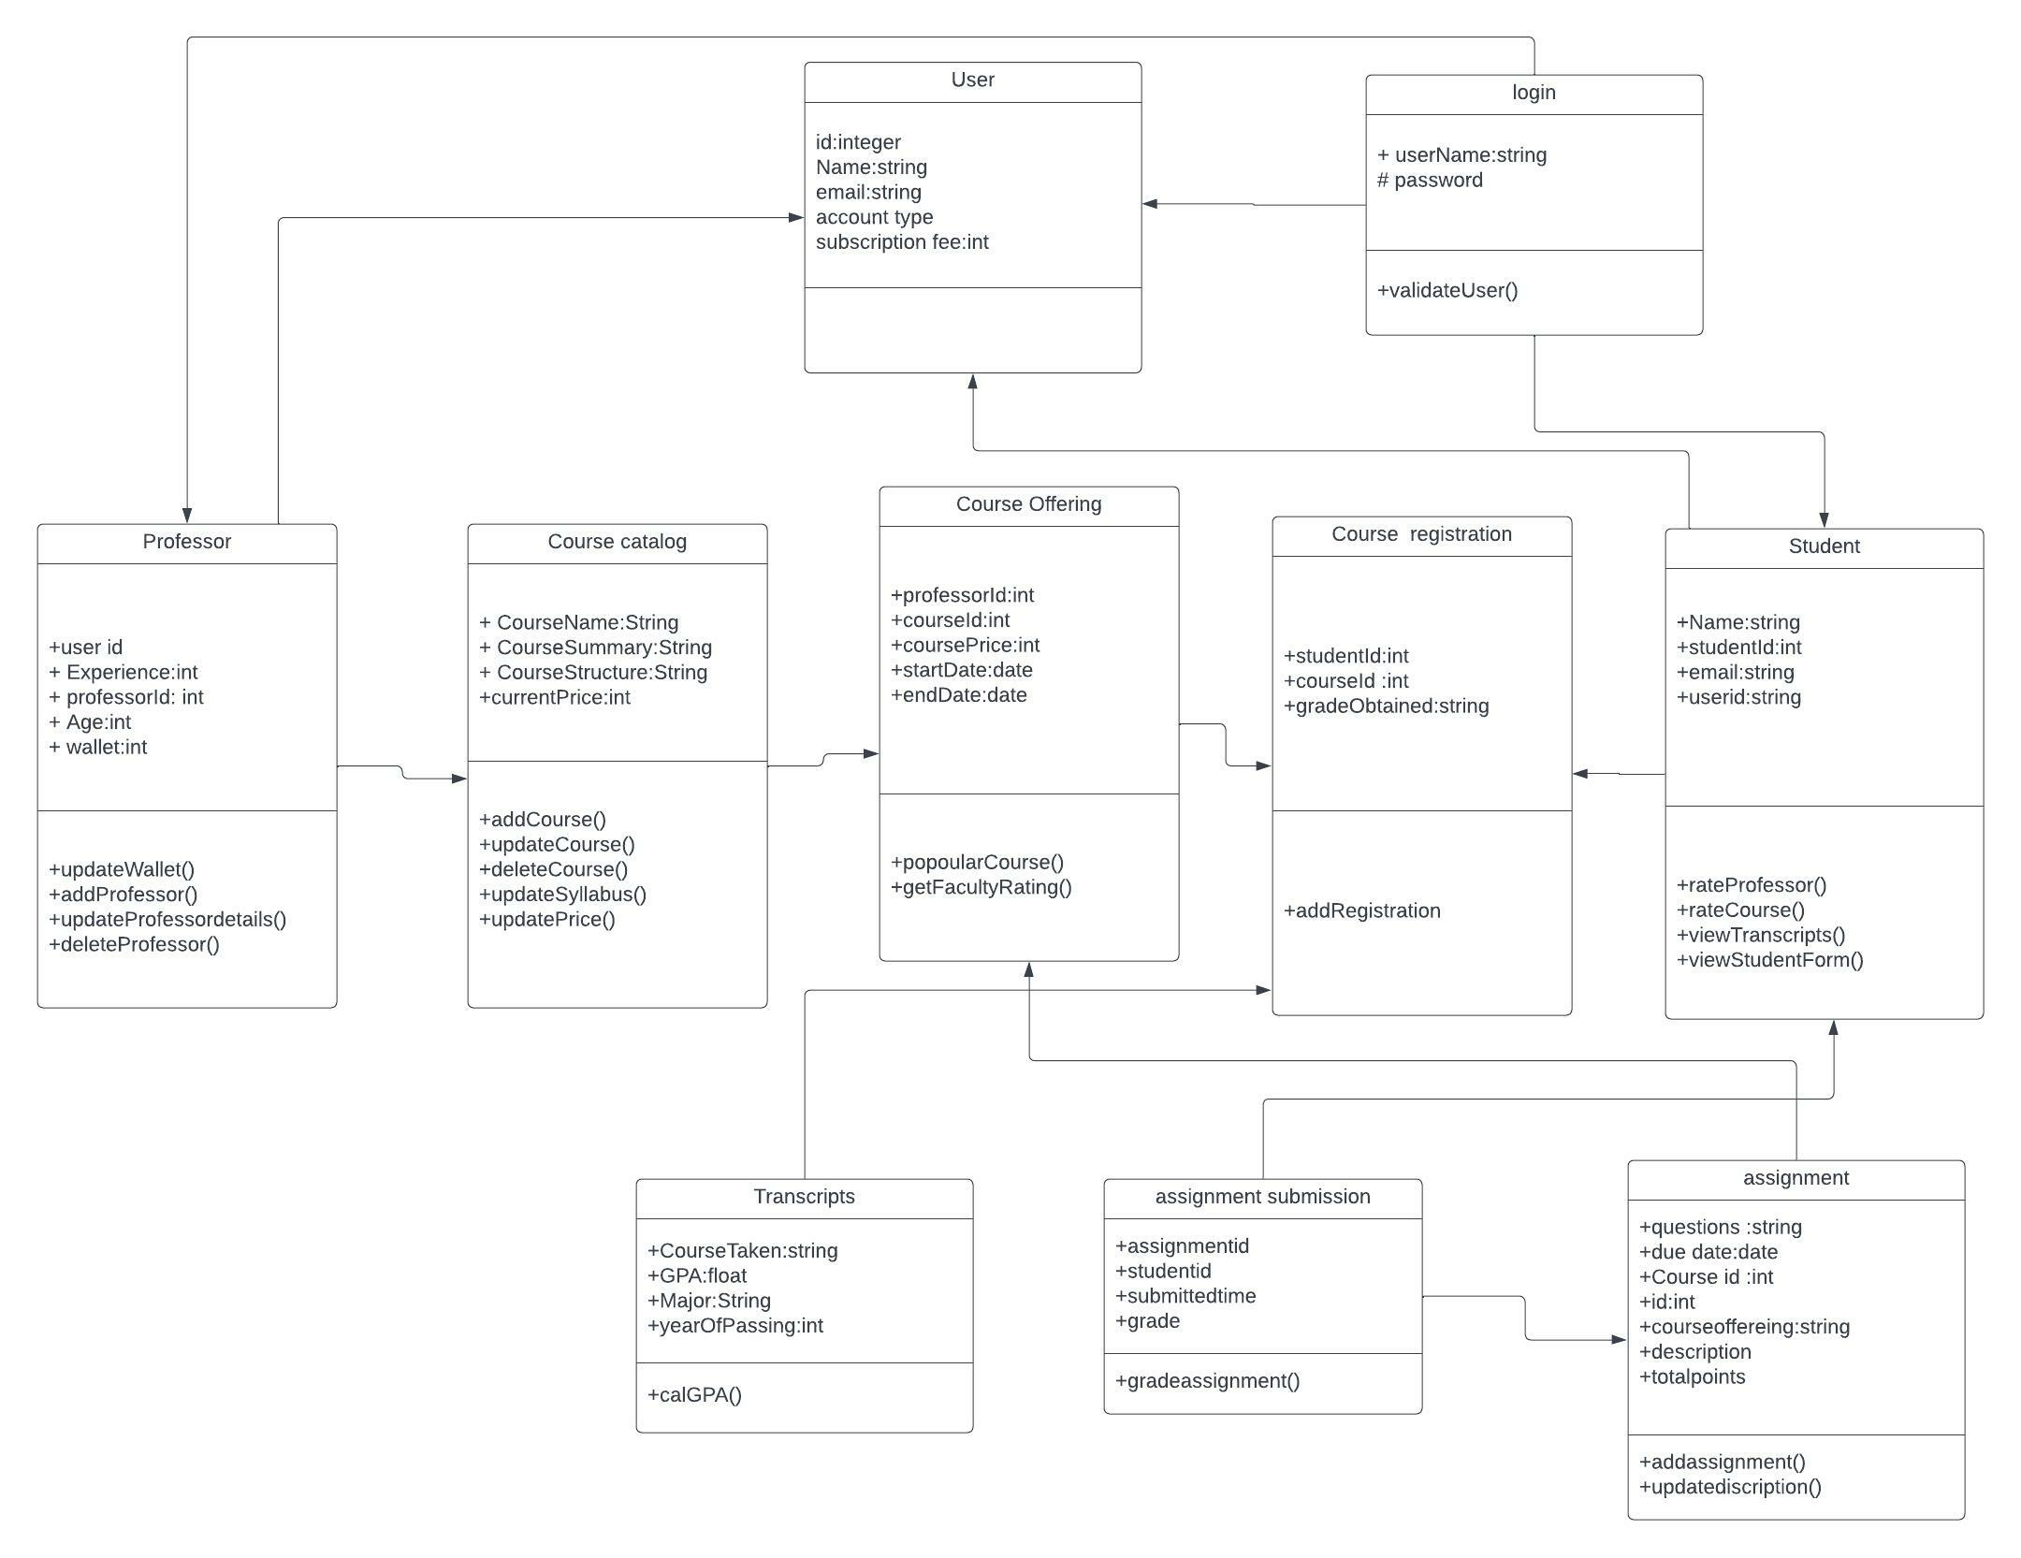

Slide 6
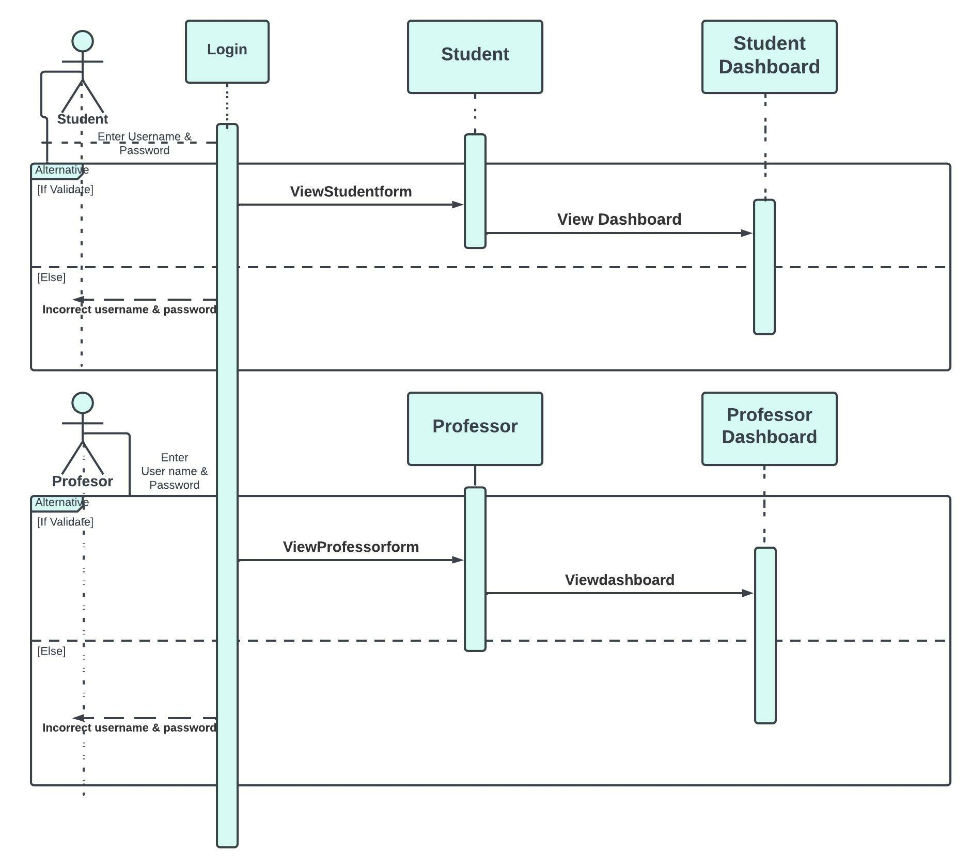
Sequence Diagram - 1

Slide 7
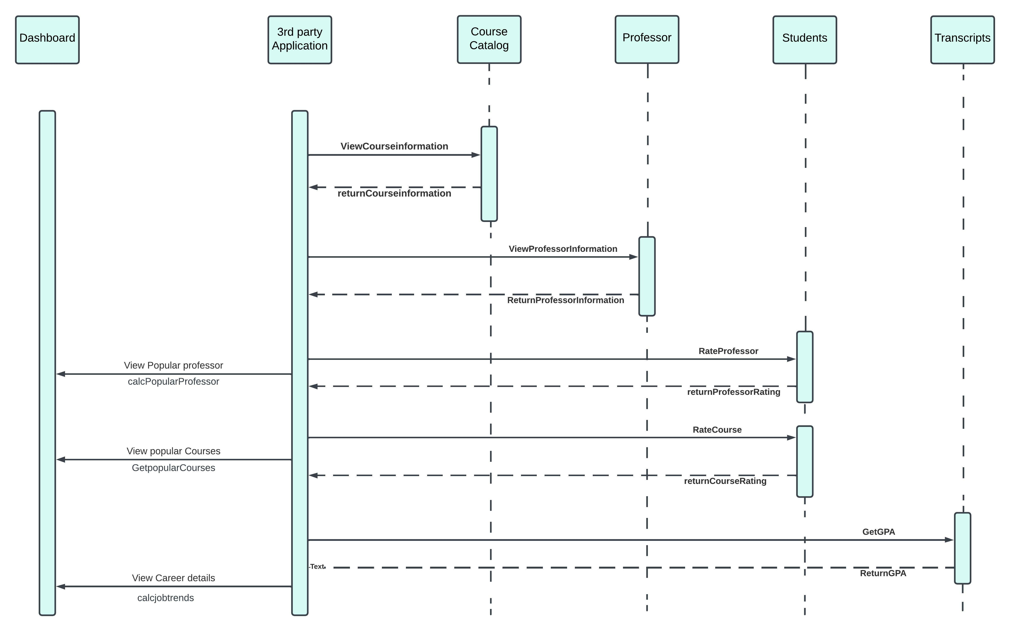
Sequence Diagram - 2

Slide 8
New Business Model – Online platform’s
Advantages :
Can be accessible form anywhere in the world using phones or laptop’s etc.
Can be recorded and use it for further references
Cost is less for online education when compared to college education.
Online platform has different options to learn many new courses
Disadvantages :
Screen time is more for a student that causes health problems.
Concentration levels may reduce
Interaction with people may cause socializing skills
Must have mobile devices to connect devices.

Slide 9
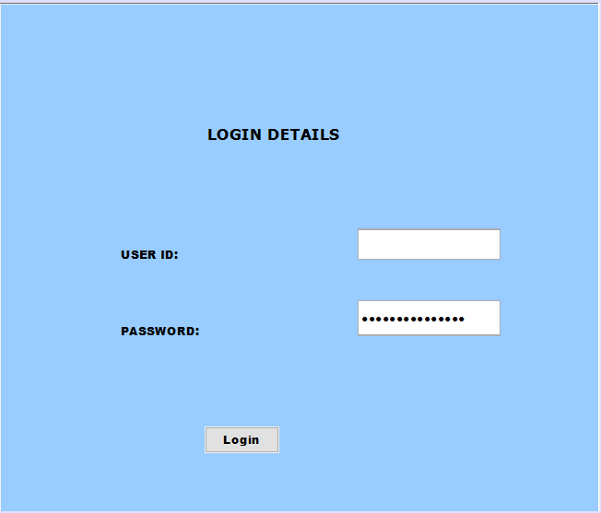

Slide 10
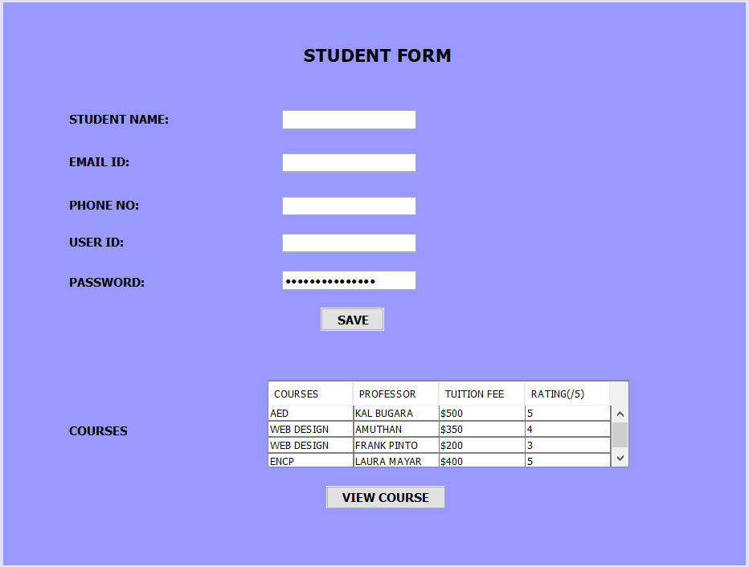

Slide 11
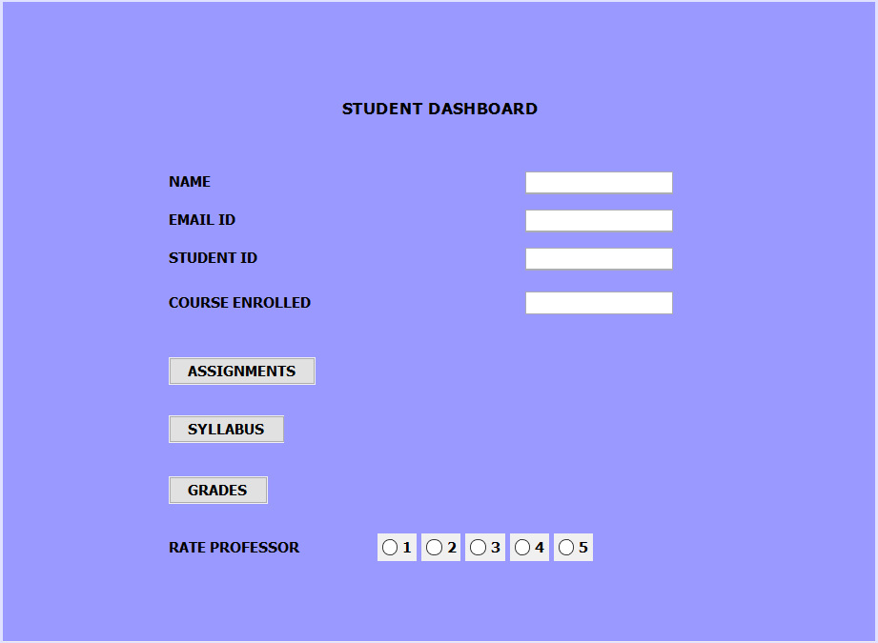

Slide 12
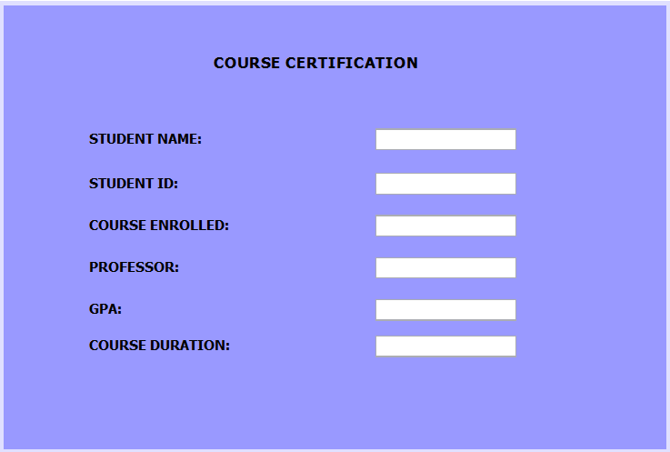

Slide 13
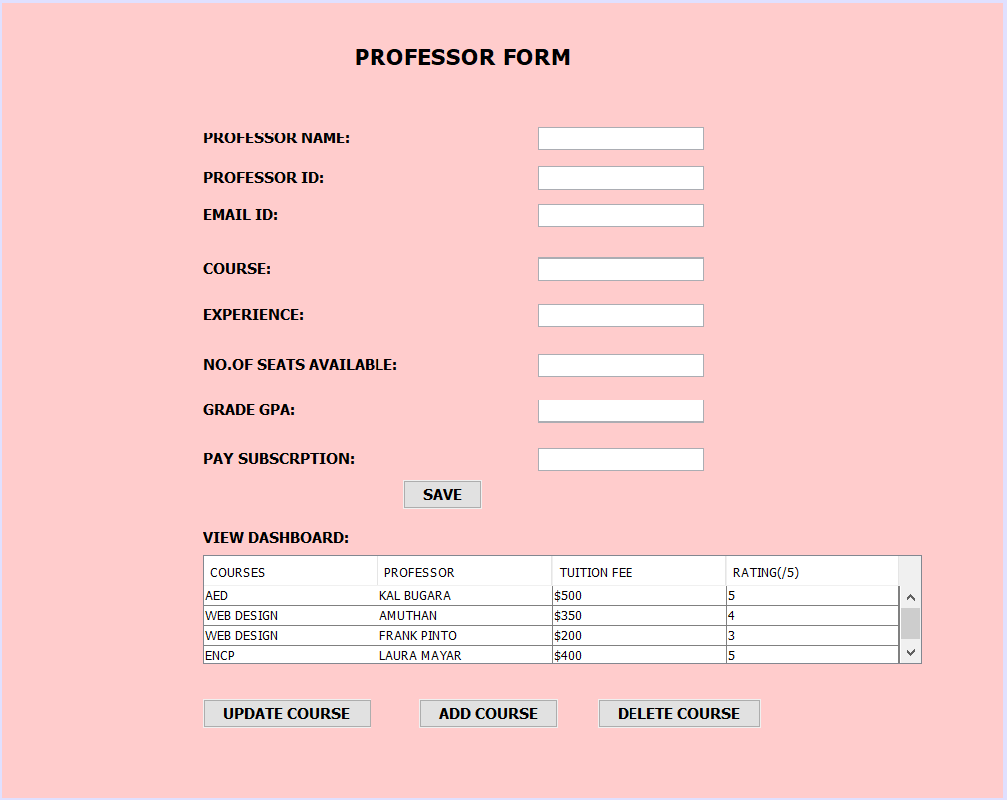

Slide 14

Thank you

